Slide 1
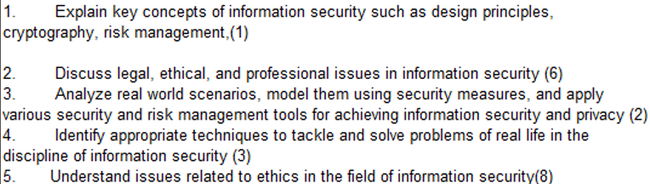
CS 3002 Information Security
Fall 2024
Week # 1 – Lecture # 1, 2, 3
Semester start: 20th August 2024
Dr. Aqsa Aslam

Slide 2
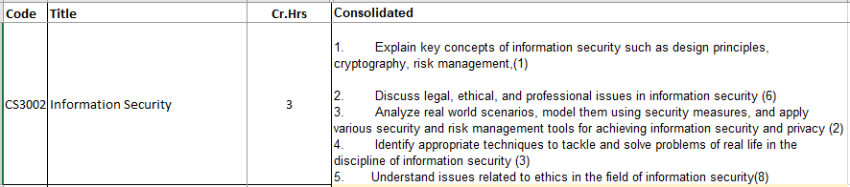
InfoSec CLOs and Course outline

Slide 3
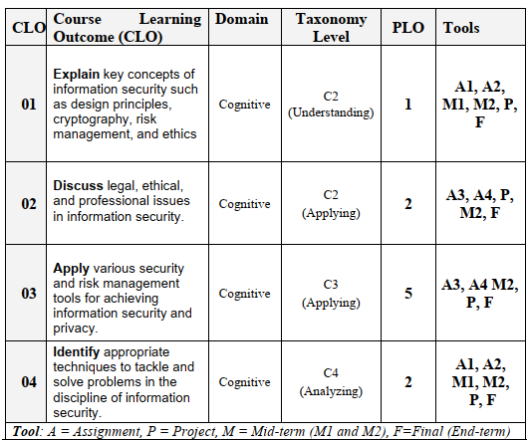

Slide 4
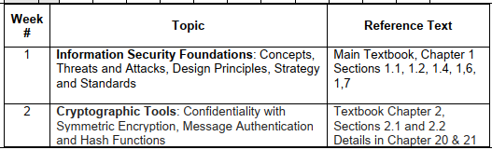
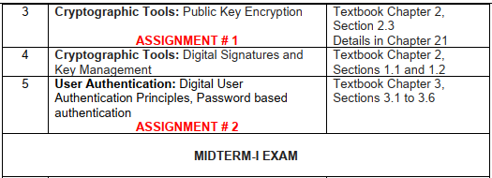

Slide 5
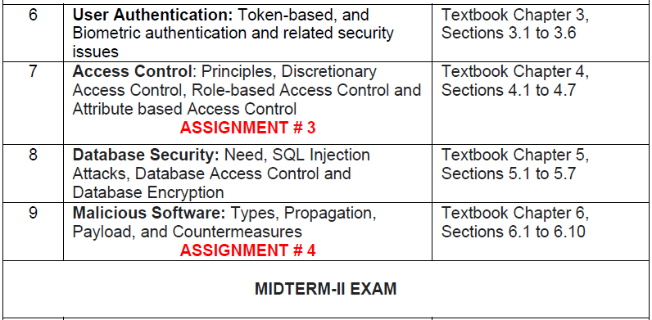

Slide 6
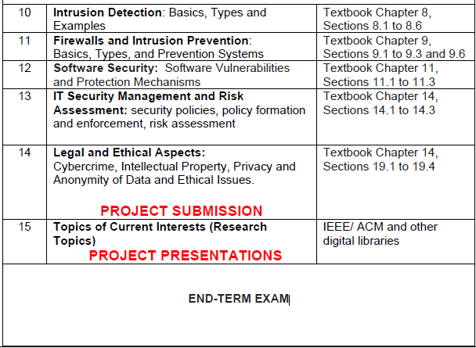

Slide 7
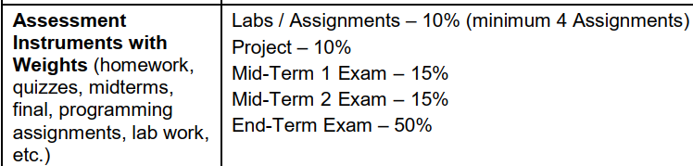
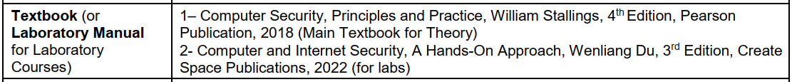
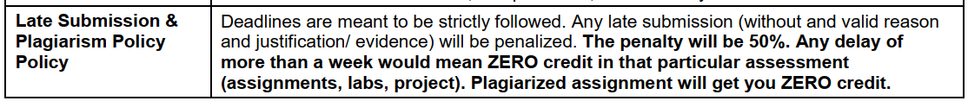

Slide 8
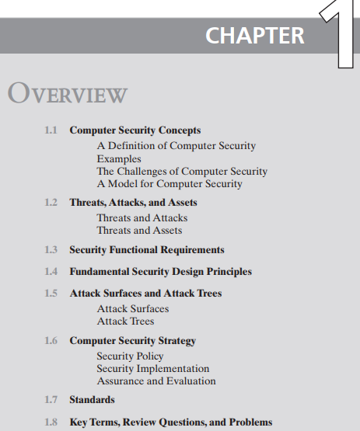
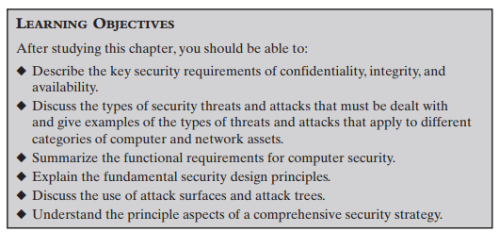



The focus of this chapter, and indeed this book, is on three fundamental questions:
1. What assets do we need to protect?
2. How are those assets threatened?
3. What can we do to counter those threats?

Slide 9


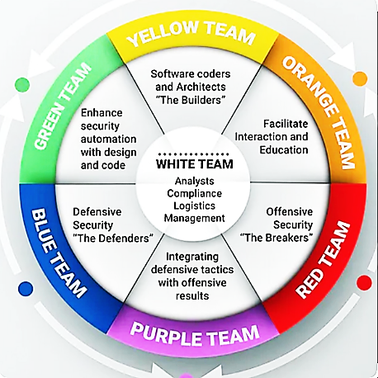
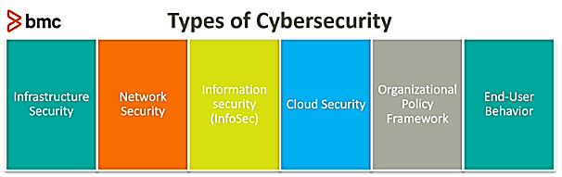

Slide 10
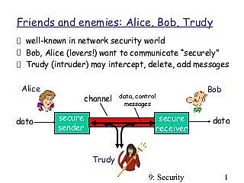

Slide 11
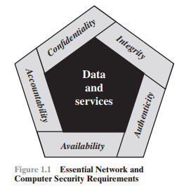
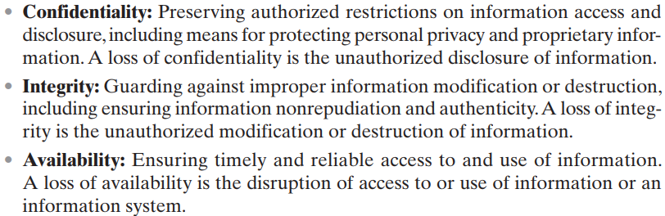






Slide 12
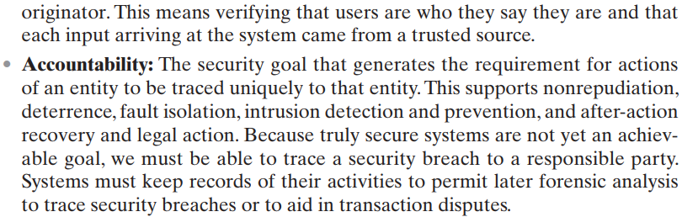




Two additional concepts are needed to present a complete picture
Low
Moderate
High
FIPS (Federal Information Processing Standards)

Slide 13

Confidentiality
Confidentiality
Protection of resources from unauthorized disclosure
Check: Who is authorized to access which resources?
Security measures
Encryption of data, resource hiding
Examples
An attacker eavesdrop a telephone conversation
An attacker reads the emails on your computer

Slide 14
Real World Examples: Confidentiality, Integrity and Availability
Impact of Risk:
Low
Moderate
High
Confidentiality
Student Grade Information:
Highly confidential and important to students.
Regulated by the Family Educational Rights and Privacy Act (FERPA) in the U.S.
Access limited to students, their parents, and necessary employees.
Student Enrollment Information:
Has a moderate confidentiality rating.
Covered by FERPA, but seen by more people daily.
Less likely to be targeted and results in less damage if disclosed compared to grade information.
Directory Information:
Includes lists of students, faculty, or departmental lists.
May have a low confidentiality rating or no rating.
Typically freely available to the public and published on a school’s website.

Slide 15
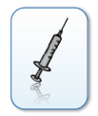
Integrity
Integrity
Protection of resources from unauthorized manipulation
Check: Who does what on which resources?
Security measures
Authorization, checksums, digital fingerprints
Examples
An attacker changes the receipt of a bank transaction
An attacker tampers with files on your computer

Slide 16
Real World Examples: Confidentiality, Integrity and Availability
Impact of Risk:
Low
Moderate
High
Integrity
High Integrity Requirement Example: Hospital Patient's Allergy Information:
Doctors must rely on the accuracy and currency of patient allergy information stored in the hospital’s database.
Authorized personnel, such as a nurse, could deliberately falsify data, posing a significant threat to patient safety.
The database should be swiftly restored to a trusted state, and it must be possible to trace any tampering back to the responsible individual.
Inaccurate information could lead to serious harm or even death, exposing the hospital to significant legal liabilities.
Moderate Integrity Requirement Example: Online Forum:
A website that hosts forums for registered users to discuss specific topics.
Both registered users and hackers could manipulate entries or deface the website.
If the forum primarily serves for user enjoyment and generates little to no revenue, the damage from such actions is limited.
The webmaster may face issues like data loss, financial setbacks, and time wastage, though the overall impact is moderate.
Low Integrity Requirement Example: Anonymous Online Poll:
Websites, including news organizations, often conduct anonymous polls with minimal security measures.
The inherent inaccuracy and lack of scientific rigor in these polls are well understood, resulting in minimal risk.
These polls have a low integrity requirement since the consequences of tampering or inaccuracy are negligible.

Slide 17

Availability
Availability
Protection of resources from unauthorized disruption
Check: When and how are which resources used?
Security Measures
Restriction, redundancy, load balancing
Examples
An attacker crashes the web server of a company
An attacker formats the hard disk of your computer

Slide 18
Real World Examples: Confidentiality, Integrity and Availability
Impact of Risk:
Low
Moderate
High
Availability
High Availability
The more critical a component or service is, the higher the required level of availability.
Example: A system that provides authentication services for critical systems, applications, and devices.
Impact of Service Interruption:
Inability for customers to access computing resources.
Staff unable to access necessary resources for critical tasks.
Consequences:
Significant financial loss due to decreased employee productivity.
Potential customer loss.
Moderate Availability
Example: Public website for a university. Provides information to current and prospective students and donors.
Impact of Unavailability: Such a site is not a critical component of the university’s information system, but its unavailability will cause some embarrassment.
Low Availability
Example: Online telephone directory lookup application.
Impact of Temporary Loss:
May be an inconvenience.
Alternative methods (e.g., hardcopy directory, operator) are available to access the information.

Slide 19
Computer Security Challenges
1. Computer security is not as simple as it might first appear to the novice
2. In developing a particular security mechanism or algorithm, one must always consider potential attacks on those security features
3. Procedures used to provide particular services are often counterintuitive
4. Physical and logical placement needs to be determined
5. Security mechanisms typically involve more than a particular algorithm or protocol and also require that participants be in possession of some secret information which raises questions about the creation, distribution, and protection of that secret information
6. Attackers only need to find a single weakness, while the designer must find and eliminate all weaknesses to achieve perfect security
9. There is a natural tendency on the part of users and system managers to perceive little benefit from security investment until a security failure occurs
8. Security requires regular and constant monitoring
7. Security is still too often an afterthought to be incorporated into a system after the design is complete, rather than being an integral part of the design process
10. Many users and even security administrators view strong security as an impediment to efficient and user-friendly operation of an information system or use of information
Notes:
Computer security is both fascinating and complex. Some of the reasons follow:
1. Computer security is not as simple as it might first appear to the novice. The
requirements seem to be straightforward; indeed, most of the major requirements
for security services can be given self-explanatory one-word labels:
confidentiality, authentication, nonrepudiation, and integrity. But the mechanisms
used to meet those requirements can be quite complex, and understanding
them may involve rather subtle reasoning.
2. In developing a particular security mechanism or algorithm, one must always consider
potential attacks on those security features. In many cases, successful attacks
are designed by looking at the problem in a completely different way, therefore
exploiting an unexpected weakness in the mechanism.
3. Because of Point 2, the procedures used to provide particular services are often
counterintuitive. Typically, a security mechanism is complex, and it is not obvious
from the statement of a particular requirement that such elaborate measures are
needed. Only when the various aspects of the threat are considered do elaborate
security mechanisms make sense.
4. Having designed various security mechanisms, it is necessary to decide where to
use them. This is true both in terms of physical placement (e.g., at what points in
a network are certain security mechanisms needed) and in a logical sense [e.g.,
at what layer or layers of an architecture such as TCP/IP (Transmission Control
Protocol/Internet Protocol) should mechanisms be placed].
5. Security mechanisms typically involve more than a particular algorithm or
protocol. They also require that participants be in possession of some secret
information (e.g., an encryption key), which raises questions about the creation,
distribution, and protection of that secret information. There may also be a reliance
on communications protocols whose behavior may complicate the task of
developing the security mechanism. For example, if the proper functioning of the
security mechanism requires setting time limits on the transit time of a message
from sender to receiver, then any protocol or network that introduces variable,
unpredictable delays may render such time limits meaningless.
6. Computer security is essentially a battle of wits between a perpetrator who tries
to find holes, and the designer or administrator who tries to close them. The great
advantage that the attacker has is that he or she need only find a single weakness,
while the designer must find and eliminate all weaknesses to achieve perfect
security.
7. There is a natural tendency on the part of users and system managers to perceive
little benefit from security investment until a security failure occurs.
8. Security requires regular, even constant monitoring, and this is difficult in today’s
short-term, overloaded environment.
9. Security is still too often an afterthought to be incorporated into a system after
the design is complete, rather than being an integral part of the design process.
10. Many users and even security administrators view strong security as an impediment
to efficient and user-friendly operation of an information system or use
of information.

Slide 20
A Model for Computer Security
Hardware
Software
Data
Communication facilities and networks
The assets of a computer system can be categorized as follows:
Hardware: Including computer systems and other data processing, data storage, and data communications devices
Software: Including the operating system, system utilities, and applications.
Data: Including files and databases, as well as security-related data,
such as password files.
Communication facilities and networks: Local and wide area network communication links, bridges, routers, and so on.
Notes:
The assets of a computer system can be categorized as follows:
• Hardware: Including computer systems and other data processing, data storage,
and data communications devices
• Software: Including the operating system, system utilities, and applications.
• Data: Including files and databases, as well as security-related data, such as
password files.
• Communication facilities and networks: Local and wide area network
communication links, bridges, routers, and so on.

Slide 21
A Model for Computer Security: Vulnerabilities, Threats and Attacks
Categories of vulnerabilities
Corrupted (loss of integrity)
For example, stored data values may differ from what they should be because they have been improperly modified.
Leaky (loss of confidentiality)
For example, someone who should not have access to some or all of the information available through the network obtains such access.
Unavailable or very slow (loss of availability)
Threats
Capable of exploiting vulnerabilities
Represent potential security harm to an asset
Attacks (threats carried out)
Passive – attempt to learn or make use of information from the system that does not affect system resources
Active – attempt to alter system resources or affect their operation
Insider – initiated by an entity inside the security perimeter
Outsider – initiated from outside the perimeter
Notes:
In the context of security, our concern is with the vulnerabilities of system
resources. [NRC02] lists the following general categories of vulnerabilities of a
computer system or network asset:
• The system can be corrupted , so it does the wrong thing or gives wrong answers.
For example, stored data values may differ from what they should be because
they have been improperly modified.
• The system can become leaky . For example, someone who should not have access to
some or all of the information available through the network obtains such
access.
• The system can become unavailable or very slow. That is, using the system or network
becomes impossible or impractical.
These three general types of vulnerability correspond to the concepts of integrity,
confidentiality, and availability, enumerated earlier in this section.
Corresponding to the various types of vulnerabilities to a system resource are
threats that are capable of exploiting those vulnerabilities. A threat represents a
potential security harm to an asset. An attack is a threat that is carried out (threat
action) and, if successful, leads to an undesirable violation of security, or threat
consequence. The agent carrying out the attack is referred to as an attacker, or
threat agent . We can distinguish two types of attacks:
• Active attack: An attempt to alter system resources or affect their operation.
• Passive attack: An attempt to learn or make use of information from the
system that does not affect system resources.
We can also classify attacks based on the origin of the attack:
• Inside attack: Initiated by an entity inside the security perimeter (an “insider”).
The insider is authorized to access system resources but uses them in a way not
approved by those who granted the authorization.
• Outside attack: Initiated from outside the perimeter, by an unauthorized or
illegitimate user of the system (an “outsider”). On the Internet, potential
outside attackers range from amateur pranksters to organized criminals, international
terrorists, and hostile governments.

Slide 22
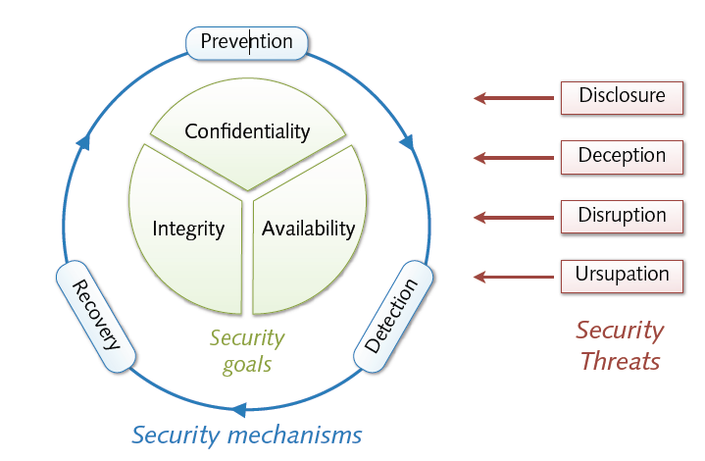
A Model for Computer Security: Countermeasures
Countermeasure: A method to deal with security attacks.
Prevention: Ideally, it stops the attack from happening.
Detection & Recovery: If prevention fails, detect the attack and recover from it.
New Vulnerabilities: Countermeasures might introduce new risks.
Residual Vulnerabilities: Some risks may still remain after applying countermeasures.
Risk Management: Asset owners aim to minimize these risks, considering other constraints.
Notes:
Finally, a countermeasure is any means taken to deal with a security attack.
Ideally, a countermeasure can be devised to prevent a particular type of attack from
succeeding.
When prevention is not possible, or fails in some instance, the goal is to
detect the attack and then recover from the effects of the attack.
A countermeasure may itself introduce new vulnerabilities.
In any case, residual vulnerabilities may remain after the imposition of countermeasures. Such vulnerabilities may be
exploited by threat agents representing a residual level of risk to the assets. Owners
will seek to minimize that risk given other constraints.

Slide 23
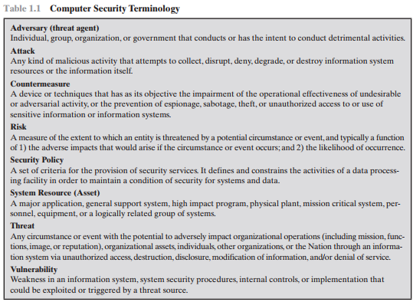
Notes:
Detrimental=harmful-→ organization, government spy, terrorist

Slide 24
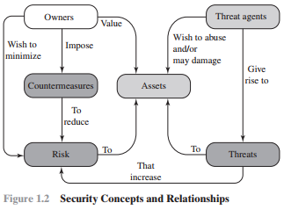

Slide 25
Example:- Security Concept and Relationships
Scenario: University Managing Student Information
Threats:
Data Breach: Unauthorized access to sensitive student records.
Data Tampering: Altering grades, academic records, or financial information.
Identity Theft: Using stolen personal information for fraudulent purposes.
Risks:
Reputation Damage: Loss of trust among students, parents, and staff if the university cannot protect student information.
Operational Disruptions: Inability to access or trust student records during a breach, affecting the university's operations.
Legal Liabilities: Potential fines or legal action if the university fails to comply with data protection regulations
Countermeasures:
Access Controls: Ensuring only authorized personnel can access sensitive student information.
Encryption: Encrypting student data to make it unreadable to unauthorized users.
Owners:
University Administration: Responsible for maintaining and securing student information
Assets:
Student Records: Includes personal information, academic records , and financial information.
Threat Agents:
Hackers: Seeking to steal personal information or disrupt university operations
Students might misuse their access to change grades or steal information
Phishers: Attempting to trick students or staff into revealing their login credentials.

Slide 26
Threats & Attacks
Basic classes of threats
Disclosure = unauthorized access to information
Deception = acceptance of false data (e.g. masquerading)
Disruption = interruption or prevention of correct operation
Usurpation = unauthorized control of resources
Attack = attempt to violate a security goal (intentional threat)
Often combinations of different threat classes

Slide 27
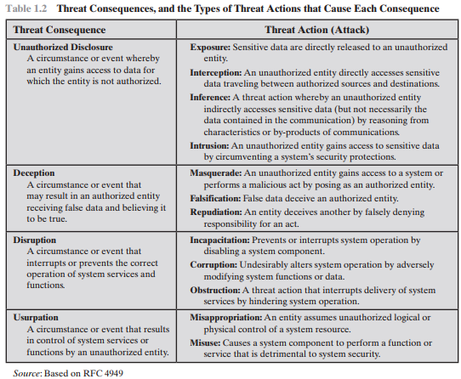
Notes:
Interception: Interception is a common attack in the context of communications.
On a shared local area network (LAN), such as a wireless LAN or a
broadcast Ethernet, any device attached to the LAN can receive a copy of
packets intended for another device. On the Internet, a determined hacker can
gain access to e-mail traffic and other data transfers.
Inference: An example of inference is known as traffic analysis, in which an
adversary is able to gain information from observing the pattern of traffic on
a network, such as the amount of traffic between particular pairs of hosts on
the network. Another example is the inference of detailed information from a
database by a user who has only limited access; this is accomplished by repeated
queries whose combined results enable inference.
Intrusion: An example of intrusion is an adversary gaining unauthorized access
to sensitive data by overcoming the system’s access control

Slide 28
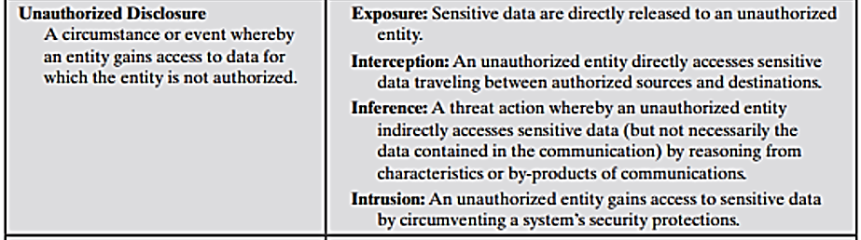
Types of attacks can result in this threat consequence:

Slide 29
Threat Consequences, and the Types of Threat Actions that Cause Each Consequence
Unauthorized Disclosure → is a threat to confidentiality.
Exposure: This can be deliberate, as when an insider intentionally releases sensitive information
Example: Universities accidentally posting confidential student information on the Web.
Interception Attack: Unauthorize access to the data
Examples: On the Internet, a determined hacker can gain access to e-mail traffic and other data transfers.
Packet sniffing and key logging to capture data from a computer system or network
Inference: Traffic analysis or use of limited access to get detailed information
Examples: Adversary is able to gain information from observing the pattern of traffic on a network such as the amount of traffic between particular pairs of hosts on the network.
Intrusion: Intrusion is an adversary (attacker) gaining unauthorized access to sensitive data by overcoming the system’s access control protections i-e unauthorized login, firewall, encryption etc.
Example: Trying to get access with different logins and passwords

Slide 30
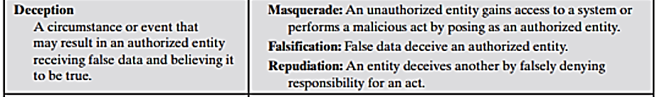
Deception → is a threat to either system integrity or data integrity (Tricking or misleading)
Masquerade: is an attempt by an unauthorized user to gain access to a system by posing as an authorized user; this could happen if the unauthorized user has learned another user’s logon ID and password.
Another example is malicious logic, such as a Trojan horse, that appears to perform a useful or desirable function but actually gains unauthorized access to system resources, or tricks a user into executing other malicious logic. (POSING)
Falsification: This refers to the altering or replacing of valid data or the introduction of false data into a file or database.
For example: a student may alter his or her grades on a school database. (ALTERING)
Repudiation: a user either denies sending data, or a user denies receiving or possessing the data.
For example: An example of a repudiation attack might be someone accessing your e-mail server and sending inflammatory information to others. This information can prove embarrassing to you or your company if this happens.(DEYNING)

Slide 31
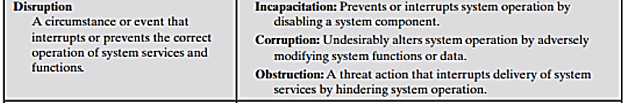
Disruption → is a threat to availability or system integrity.
Incapacitation: Disables a system, making it completely or partially unusable.
Example: Malicious software, such as Trojan horses, viruses, or worms, could operate in such a way as to disable a system or some of its services.
Corruption: Alters system data or functions, causing unintended behavior.
Example: a user placing backdoor logic in the system to provide subsequent access to a system and its resources by other than the usual procedure e.g. Ransome
Obstruction: Disrupts system operations, often by overwhelming or misrouting resources.
Example:-One way to obstruct system operation is to interfere with communications by disabling communication links or altering communication control information.

Slide 32
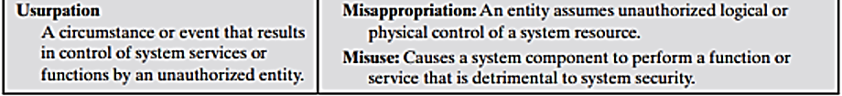
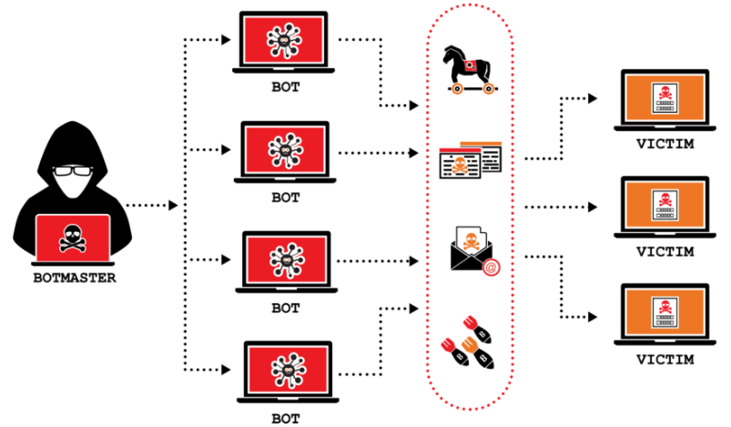
Usurpation → is a threat to system integrity.
Misappropriation: unauthorized use or theft of system resources, typically for the attacker's benefit.
Example: is a distributed denial of service attack, when malicious software is installed on a number of hosts to be used as platforms to launch traffic at a target host. In this case, the malicious software makes unauthorized use of processor and operating system resources.
Misuse: Misuse can occur by means of either malicious logic or a hacker that has gained unauthorized access to a system. In either case, security functions can be disabled or thwarted.
Example: Antivirus is disable attacker can attack computer.

Slide 33
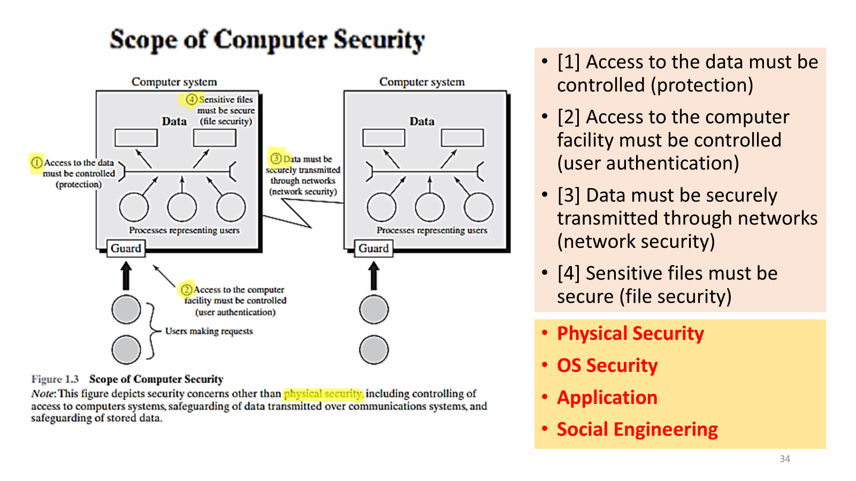

Slide 34
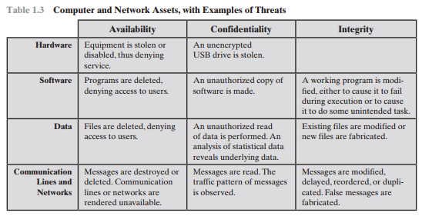

Slide 35
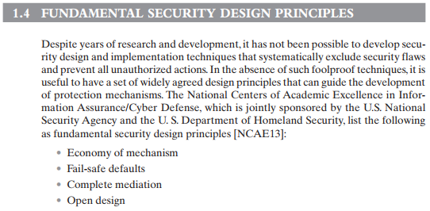


Notes:
Economy of mechanism means the design of security measures embodied in both hardware and software should be as simple and small as possible. The motivation
for this principle is that relatively simple, small design is easier to test and verify thoroughly. With a complex design, there are many more opportunities for an adversary
to discover.
Fail-safe default means access decisions should be based on permission rather than exclusion. That is, the default situation is lack of access, and the protection scheme identifies conditions under which access is permitted.
For example, most file access systems work on this principle and virtually all protected services on client/server systems work this way.
Complete mediation means every access must be checked against the access control mechanism. Systems should not rely on access decisions retrieved from
a cache.
Open design means the design of a security mechanism should be open rather
than secret. For example, although encryption keys must be secret, encryption
Algorithms should be open to public scrutiny.
Separation of privilege is defined in [SALT75] as a practice in which multiple privilege attributes are required to achieve access to a restricted resource.
A good example of this is multifactor user authentication, which requires the use of multiple techniques, such as a password and a smart card, to authorize a user.
Least privilege means every process and every user of the system should operate using the least set of privileges necessary to perform the task. A good example of the
use of this principle is role-based access control, as will be described in Chapter 4.
Least common mechanism means the design should minimize the functions shared by different users, providing mutual security. This principle helps reduce the
number of unintended communication paths and reduces the amount of hardware and software on which all users depend, thus making it easier to verify if there are
any undesirable security implications.
Psychological acceptability implies the security mechanisms should not Interfere unduly with the work of users, and at the same time meet the needs of those who authorize access.
Isolation is a principle that applies in three contexts. First, public access systems should be isolated from critical resources (data, processes, etc.) to prevent disclosure
or tampering.
Encapsulation can be viewed as a specific form of isolation based on object oriented functionality.
Modularity in the context of security refers both to the development of security functions as separate, protected modules, and to the use of a modular architecture
for mechanism design and implementation.
Layering refers to the use of multiple, overlapping protection approaches addressing the people, technology, and operational aspects of information systems.
Least astonishment means a program or user interface should always respond in the way that is least likely to astonish the user. For example, the mechanism for
authorization should be transparent enough to a user that the user has a good intuitive understanding of how the security goals map to the provided security mechanism.

Slide 36
Fundamental Security Design Principles
Economy of mechanism: Keep security mechanisms as simple and straightforward as possible. This reduces the potential for errors and vulnerabilities that can arise from complex designs.
Fail-safe default: The default action should be to deny access or secure access.
For example: If the firewall fails, let no traffic in
Complete mediation: Ensure that every access to a resource is checked for authorization (usually check once).
For example: if you change the password it asks for an authentication
Open design: This means the design of a security mechanism should be open rather than secret.
For example: Although encryption keys must be secret, encryption algorithms should be open to public investigation
Separation of privilege: Multiple privilege attributes are required to achieve access to a restricted resource. (Access should not granted based on a single attribute)
For example: The use of multiple techniques, such as a password and a smart card, to authorize a user (Multifactor authentication)
Least privilege: Grant users and processes only the minimum permissions necessary to perform their tasks.
For example: Role Based Access Control (RBAC) Model
Least common mechanism: Sharing components or resources among different users or processes should be minimum possible. This reduces the potential for one user's actions affecting another user’s security.
For example In stack, if a user is sharing the file in user module, it should be in the user module

Slide 37
Fundamental Security Design Principles
Psychological acceptability: Security measures should be designed in a way that it introduce a minimum hurdles to the user of the system.
For example: if person come to the campus it has to go through with the eye scan instead of access card
Isolation: the system that has a critical data, process or resources must be isolated such that it restrict public access
For example: Multiple users in the same operating system, each user will manage its own account (isolated from each other) OR also example of VM
Encapsulation: is a specific form of isolation based on object oriented functionality.
For example: if you are designing a password module the algorithm and methods of password will create in a class.
Modularity: The security mechanism must of generated as separate and protected modules and using the modular architecture.
Layering: refers to the use of multiple, overlapping protection approaches addressing the people, technology, and operational aspects of information systems
For example: Multiple barrier for the attacker if try to access the information (type of user, identification, firewall)
Least astonishment: The user interface of the system must not amaze the user while accessing the secure system

Slide 38
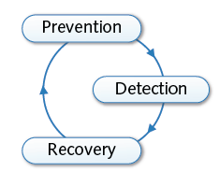

Computer Security Strategy
Security policies and mechanisms
Policy = statement of what is and what is not allowed
Mechanism = method or tool enforcing a security policy
Strategies for security mechanisms
Prevention of attacks
Detection of attacks
Recovery from attacks
Bruce Schneier: Security is a process, not a product!

Slide 39
Prevention
Prevention of attacks
Prevention of attacks prior to violation of security goals
Examples
Data reduction and separation
Removal or separation of information and resources
Authentication and encryption
Restriction of access to information and resources
Limitations
Inapplicable in many settings, e.g. open services

Slide 40
Detection
Detection of attacks
Detection of attacks during violation of security goals
Examples
Anti-virus scanners
Detection of malicious code on computers
Network intrusion detection
Detection of attacks in computer networks
Limitations
Ineffective against unknown and “invisible” attacks

Slide 41
Recovery
Recovery
Recovery from attacks after violation of security goals
Examples
Computer forensics
Investigation and analysis of security incidents
Malware analysis
Observation and analysis of malicious software
Limitations
Severe damage might have already occurred

Slide 42

